Slide 1

On amortized optimization for RL, Bayesian optimization, and biology
Brandon Amos • Meta, NYC
slides
bamos.github.io/presentations

Slide 2
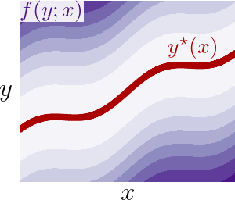
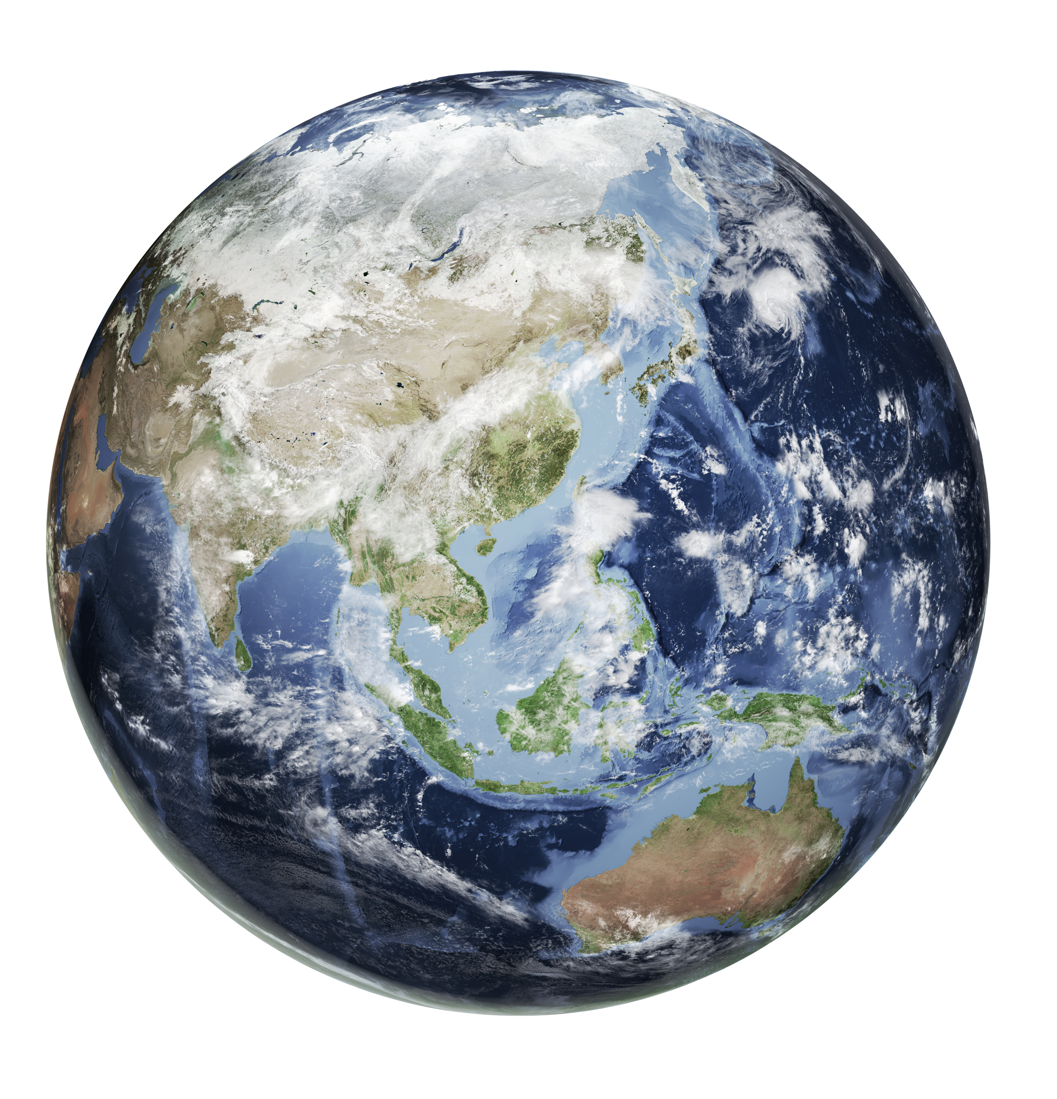



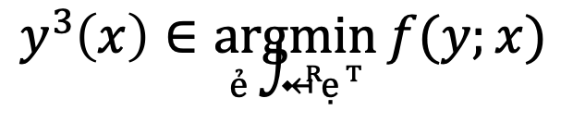
Optimization: interacting with the world
optimal solution
objective
context (or parameterization)
$$y^{⋆}\left(x\right)∈\underset{y∈𝒞(x)}{argmin}{f(y;x)}$$
optimization variable
constraints
vertical slices are optimization problems

Slide 3
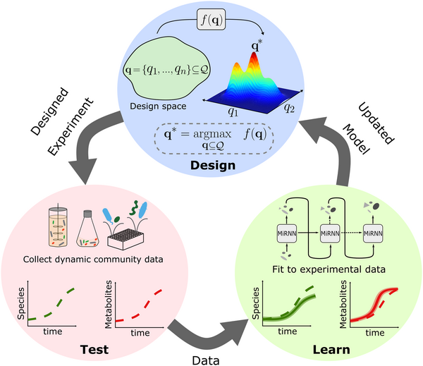
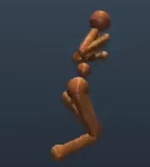
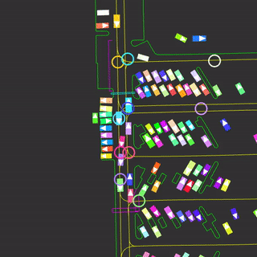
Optimization and biology
(an incomplete and non-exhaustive list)
Interactions (RL, control, experimental design, Bayesian optimization)
Source: Integrating a tailored recurrent neural network with Bayesian experimental design to optimize microbial community functions

Slide 4
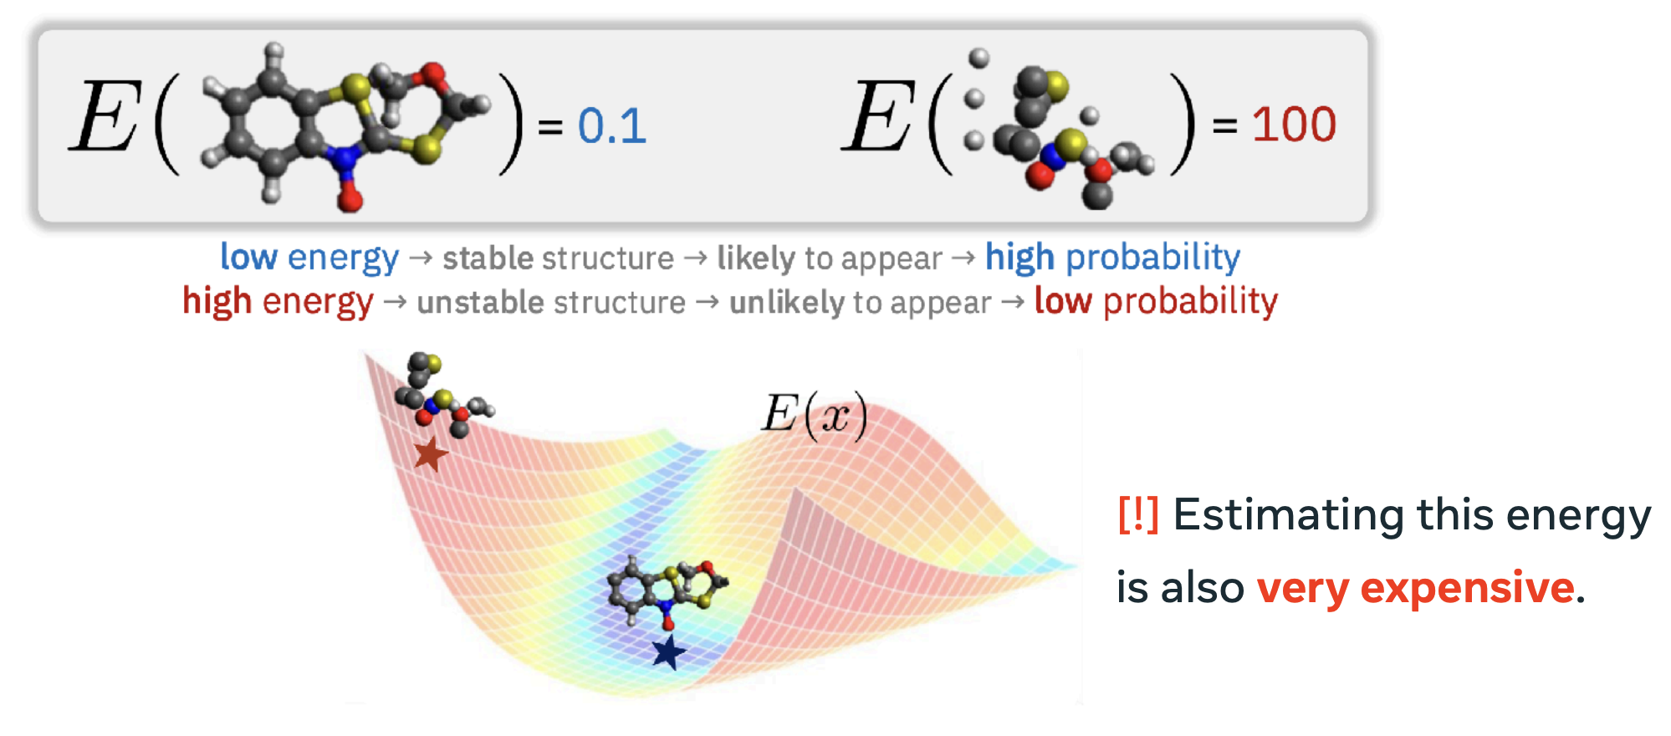

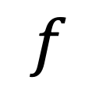
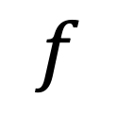
Optimization and biology
(an incomplete and non-exhaustive list)
Interactions (RL, control, experimental design, Bayesian optimization)
Conformer and molecular generation
$$f$$
$$f$$
Source: Ricky Chen, Stochastic Control for Large Scale Reward-Driven Generative Modeling

Slide 5
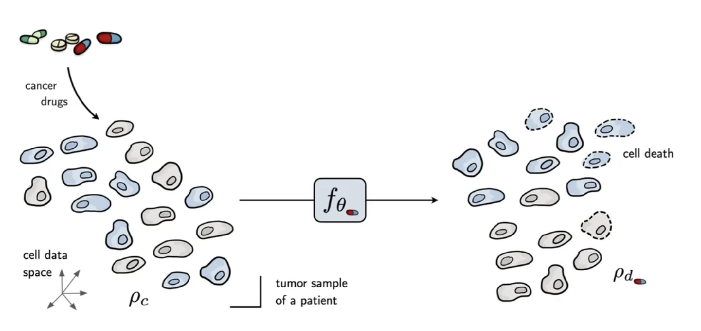
Optimization and biology
(an incomplete and non-exhaustive list)
Interactions (RL, control, experimental design, Bayesian optimization)
Conformer and molecular generation
Transport and flows between cells (to recover the development process)
(find a transport path between populations of cells)
Image source: Bunne et al.

Slide 6
Optimization and biology
(an incomplete and non-exhaustive list)
Interactions (RL, control, experimental design, Bayesian optimization)
Conformer and molecular generation
Transport and flows between cells (to recover the development process)
Challenge: solving a single optimization problem is hard
(find a transport path between populations of cells)
Image source: Bunne et al.

Slide 7
Optimization and biology
(an incomplete and non-exhaustive list)
Interactions (RL, control, experimental design, Bayesian optimization)
Conformer and molecular generation
Transport and flows between cells (to recover the development process)
Challenge: solving a single optimization problem is hard
(find a transport path between populations of cells)
This talk: learn a fast solver (amortization)
Image source: Bunne et al.

Slide 8
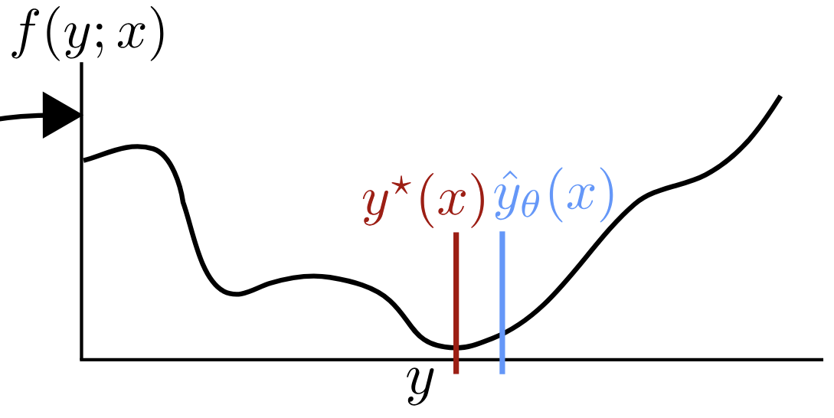

Optimization and fast and slow thinking
slow thinking: solve from scratch (e.g., with search, planning)
(amortization)
fast thinking: rapidly predict the solution
why? can be 25,000+ times faster (in VAEs)

Slide 9
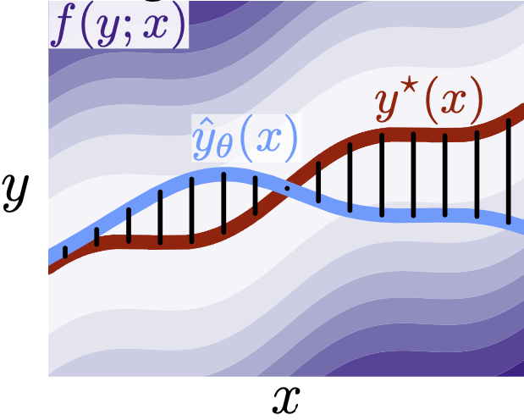
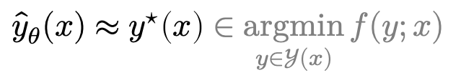
Why call it amortized optimization?
📚 Tutorial on amortized optimization. Amos. FnT in ML, 2023.
*also referred to as learned optimization
to amortize: to spread out an upfront cost over time
$${\hat{y}}_{θ}(x)≈y^{⋆}\left(x\right)∈\underset{y∈𝒴(x)}{argmin}{f(y;x)}$$
expensive upfront cost
training the model
fast approximate solutions
(vertical slices are optimization problems)

Slide 10
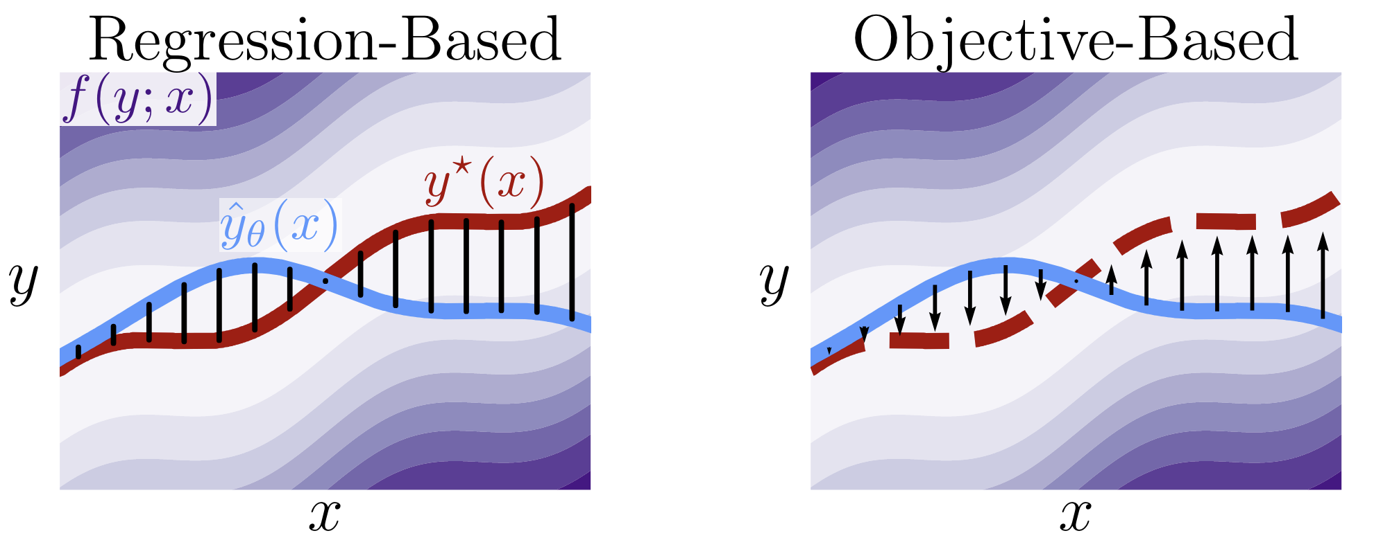
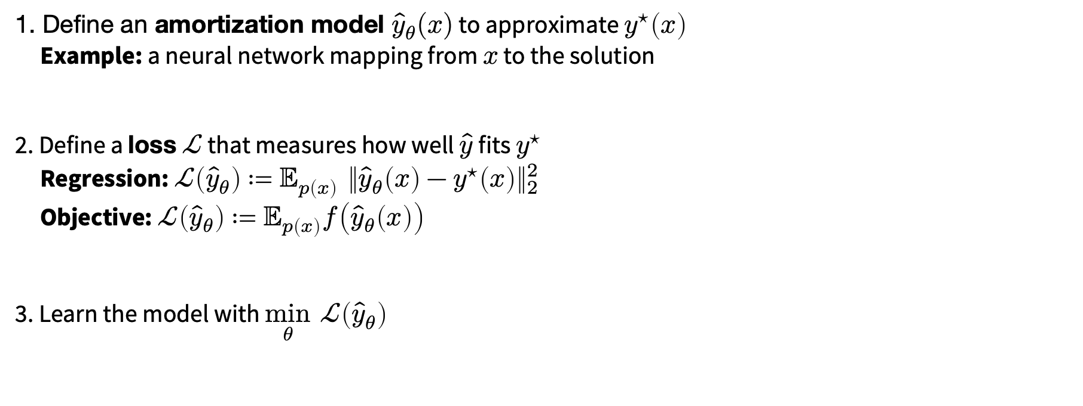
How to amortize? The basic pieces
📚 Tutorial on amortized optimization. Amos, Foundations and Trends in Machine Learning 2023.
1. Define an amortization model ${\hat{y}}_{θ}(x)$ to approximate $y^{⋆}\left(x\right)$
Example: a neural network mapping from $x$ to the solution
2. Define a loss $ℒ$ that measures how well $\hat{y}$ fits $y^{⋆}$
Regression: $ℒ\left({\hat{y}}_{θ}\right)≔𝔼_{p\left(x\right)} {\left\|{\hat{y}}_{θ}\left(x\right)−y^{⋆}\left(x\right)\right\|}_{2}^{2}$
Objective: $ℒ\left({\hat{y}}_{θ}\right)≔𝔼_{p\left(x\right)}f\left({\hat{y}}_{θ}\left(x\right)\right)$
3. Learn the model with $\min_{θ} ℒ\left({\hat{y}}_{θ}\right)$
(vertical slices are optimization problems)

Slide 11
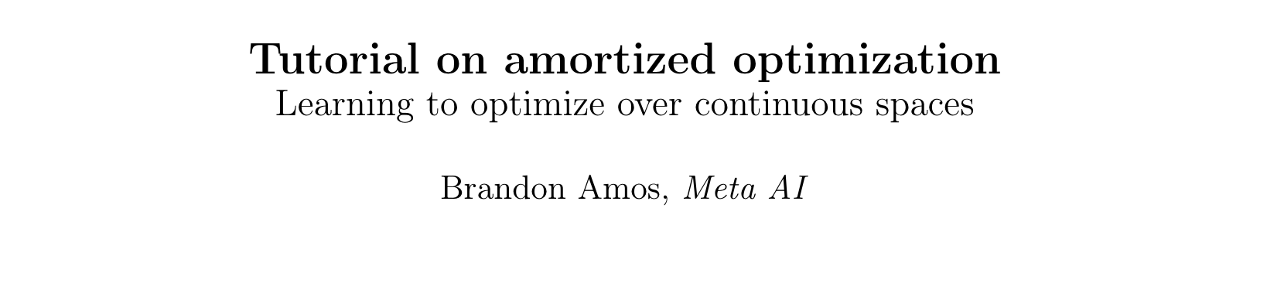
Existing, widely-deployed uses of amortization
📚 Tutorial on amortized optimization. Amos, Foundations and Trends in Machine Learning 2023.
Reinforcement learning and control (actor-critic methods, SAC, DDPG, GPS, BC)
Variational inference (VAEs, semi-amortized VAEs)
Meta-learning (HyperNets, MAML)
Sparse coding (PSD, LISTA)
Roots, fixed points, and convex optimization (NeuralDEQs, RLQP, NeuralSCS)
Foundations and Trends® in Machine Learning

Slide 12
Overview
Introduction and motivation for amortization
Warmup: reinforcement learning as amortization
Learning update rules Learning to learn by gradient descent by gradient descent
Learning to learn without gradient descent by gradient descent
Meta Optimal Transport and Meta Flow Matching

Slide 13
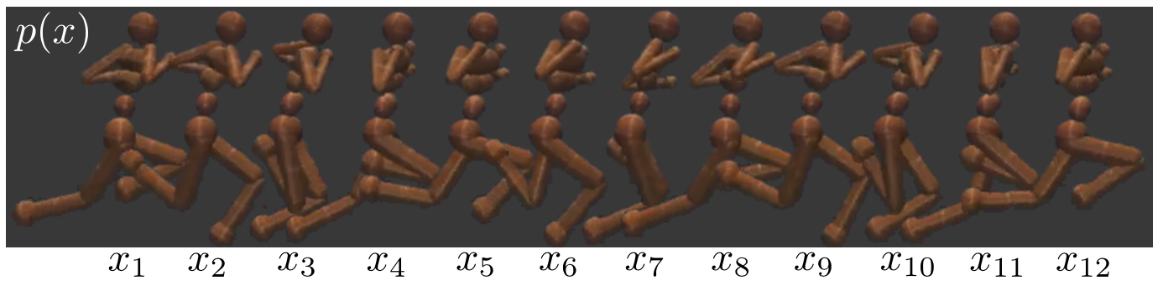
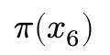
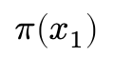
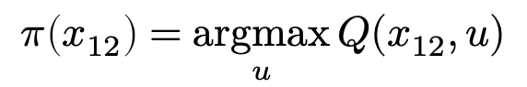
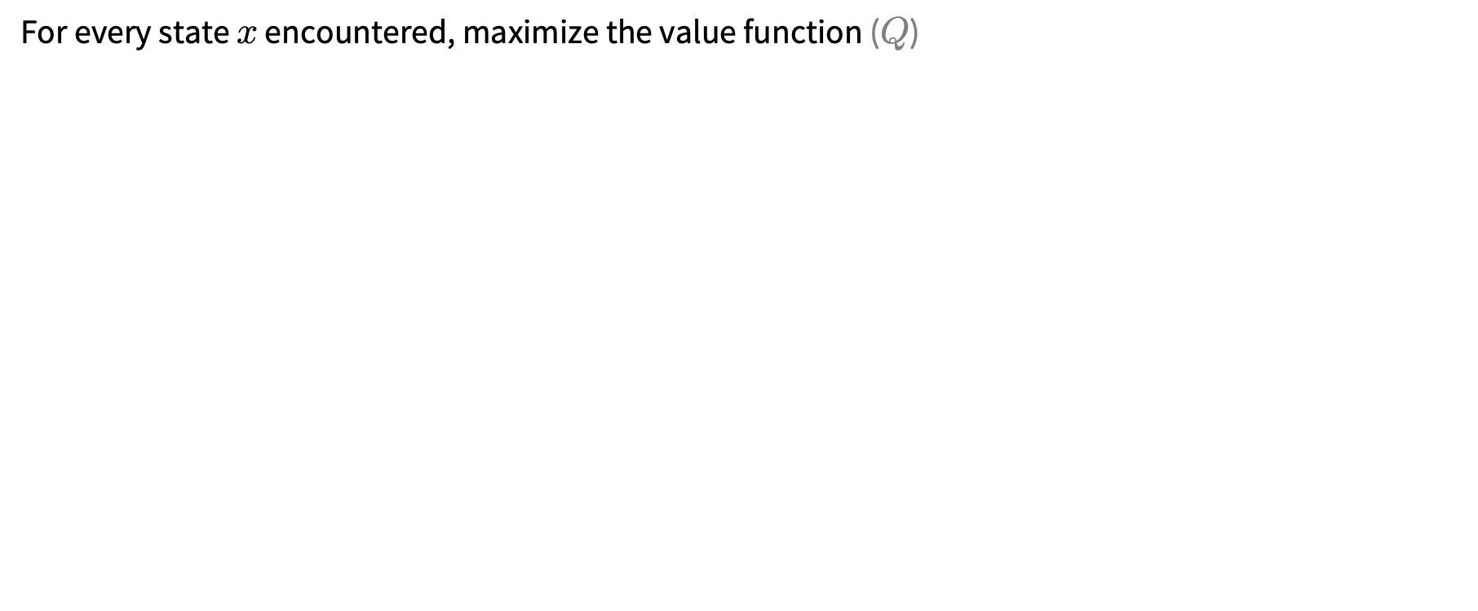
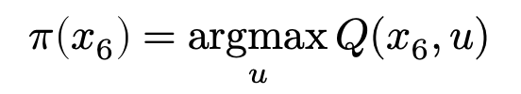
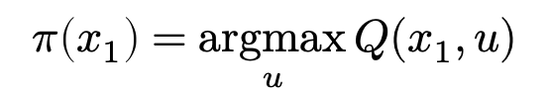
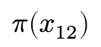
Reinforcement learning
For every state $x$ encountered, maximize the value function ($Q$)
$$π\left(x_{1}\right)$$
$$π\left(x_{6}\right)$$
$$π\left(x_{12}\right)$$
value
action
action
action
$$π\left(x_{1}\right)=\underset{u}{argmax}{Q(x_{1},u)}$$
$$π\left(x_{6}\right)=\underset{u}{argmax}{Q(x_{6},u)}$$
$$π\left(x_{12}\right)=\underset{u}{argmax}{Q(x_{12},u)}$$

Slide 14
Reinforcement learning
For every state $x$ encountered, maximize the value function ($Q$)
Independently solving from scratch is expensive!!
$$π\left(x_{1}\right)$$
$$π\left(x_{6}\right)$$
$$π\left(x_{12}\right)$$
value
action
action
action
$$π\left(x_{1}\right)=\underset{u}{argmax}{Q(x_{1},u)}$$
$$π\left(x_{6}\right)=\underset{u}{argmax}{Q(x_{6},u)}$$
$$π\left(x_{12}\right)=\underset{u}{argmax}{Q(x_{12},u)}$$

Slide 15
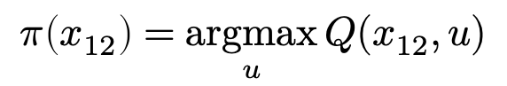
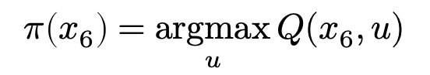
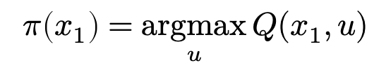
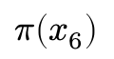

Policy learning
Learn $π_{θ}$ to predict the solution for every state 👍
$$π\left(x_{6}\right)$$
value
action
action
action
$$π\left(x_{1}\right)=\underset{u}{argmax}{Q(x_{1},u)}$$
$$π\left(x_{6}\right)=\underset{u}{argmax}{Q(x_{6},u)}$$
$$π\left(x_{12}\right)=\underset{u}{argmax}{Q(x_{12},u)}$$

Slide 16
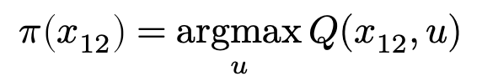
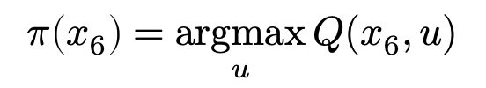
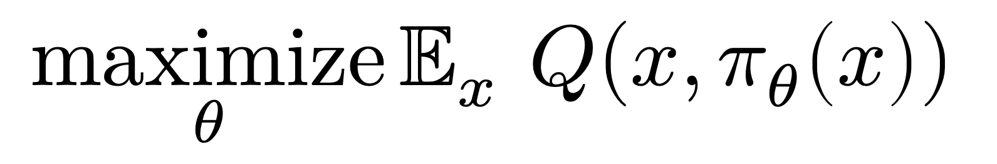
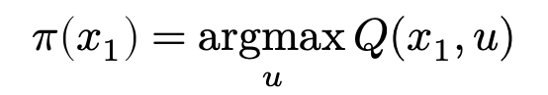
Policy learning: amortize across states
$$\underset{θ}{maximize}{𝔼_{x} Q(x, π_{θ}\left(x\right))}$$
value
action
action
action
$$π\left(x_{1}\right)=\underset{u}{argmax}{Q(x_{1},u)}$$
$$π\left(x_{6}\right)=\underset{u}{argmax}{Q(x_{6},u)}$$
$$π\left(x_{12}\right)=\underset{u}{argmax}{Q(x_{12},u)}$$

Slide 17
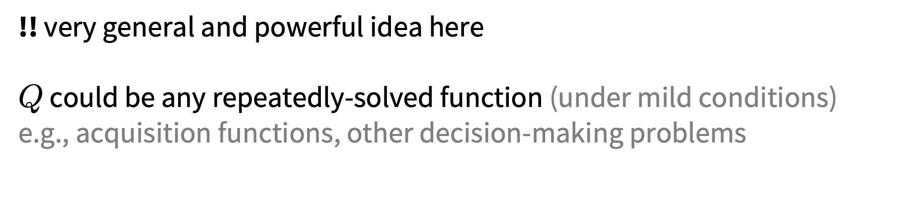
Policy learning: amortize across states
$$\underset{θ}{maximize}{𝔼_{x} Q(x, π_{θ}\left(x\right))}$$
!! very general and powerful idea here
$Q$ could be any repeatedly-solved function (under mild conditions)
e.g., acquisition functions, other decision-making problems
Foundations and Trends® in Machine Learning

Slide 18
Overview
Introduction and motivation for amortization
Warmup: reinforcement learning as amortization
Learning update rules Learning to learn by gradient descent by gradient descent
Learning to learn without gradient descent by gradient descent
Meta Optimal Transport and Meta Flow Matching

Slide 19
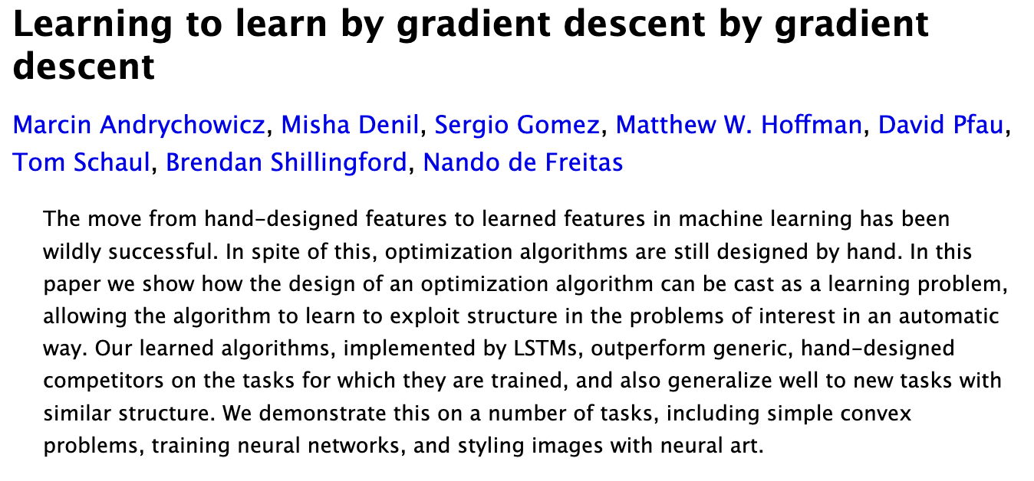
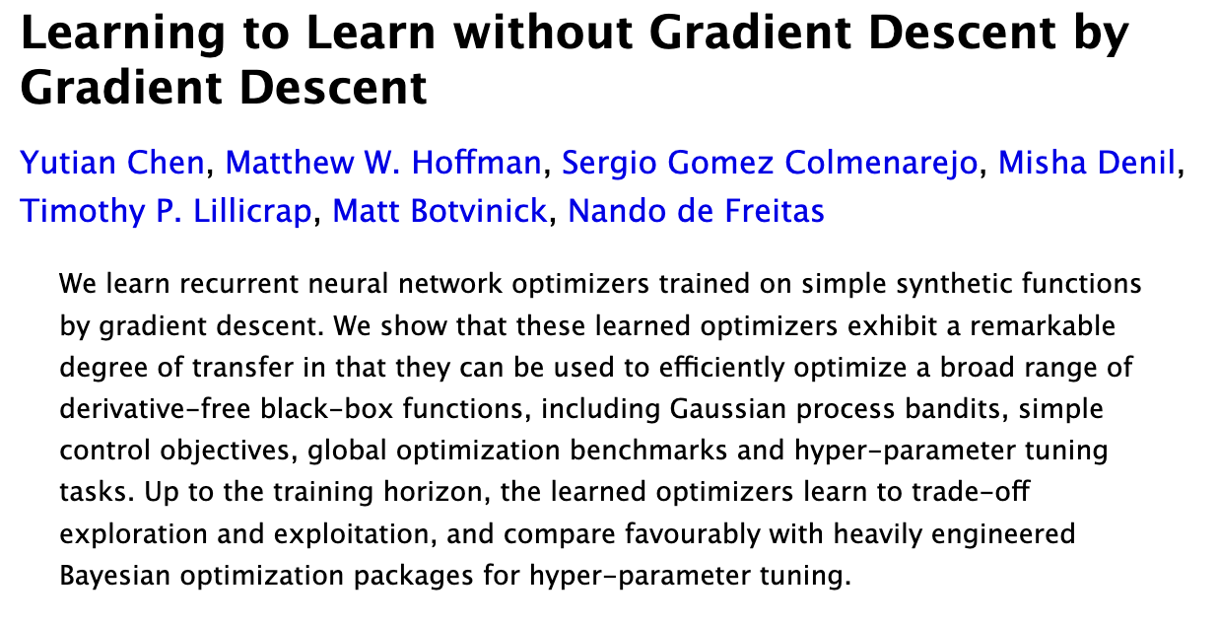
On learning update rules
(many others in the citation graph around these)
NeurIPS 2016
ICML 2017

Slide 20
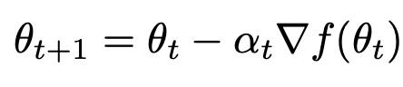
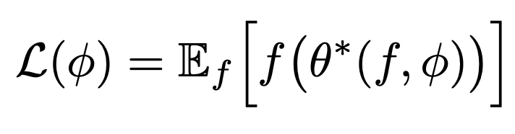
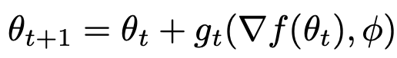
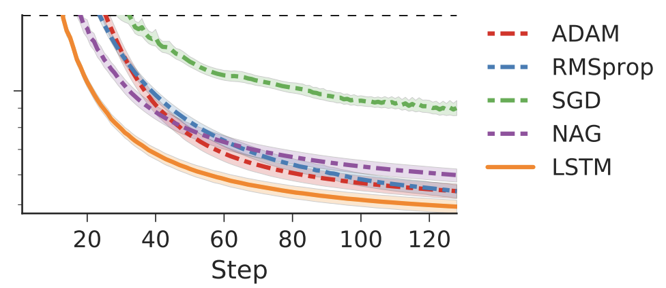
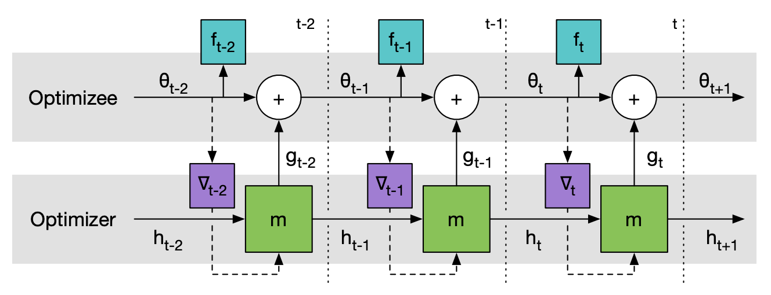
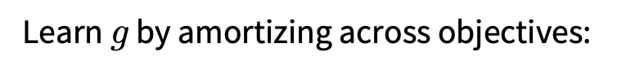
Learning to learn by gradient descent by gradient descent
Start with gradient descent:
Replace the update with a learned rule (an LSTM):
Learn $g$ by amortizing across objectives:

Slide 21
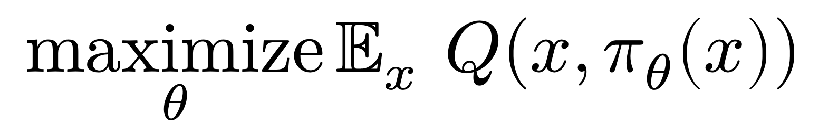
Learning to learn by gradient descent by gradient descent
Start with gradient descent:
Replace the update with a learned rule (an LSTM):
Learn $g$ by amortizing across objectives:
!! identical to amortization for policies in RL
$$\underset{θ}{maximize}{𝔼_{x} Q(x, π_{θ}\left(x\right))}$$

Slide 22
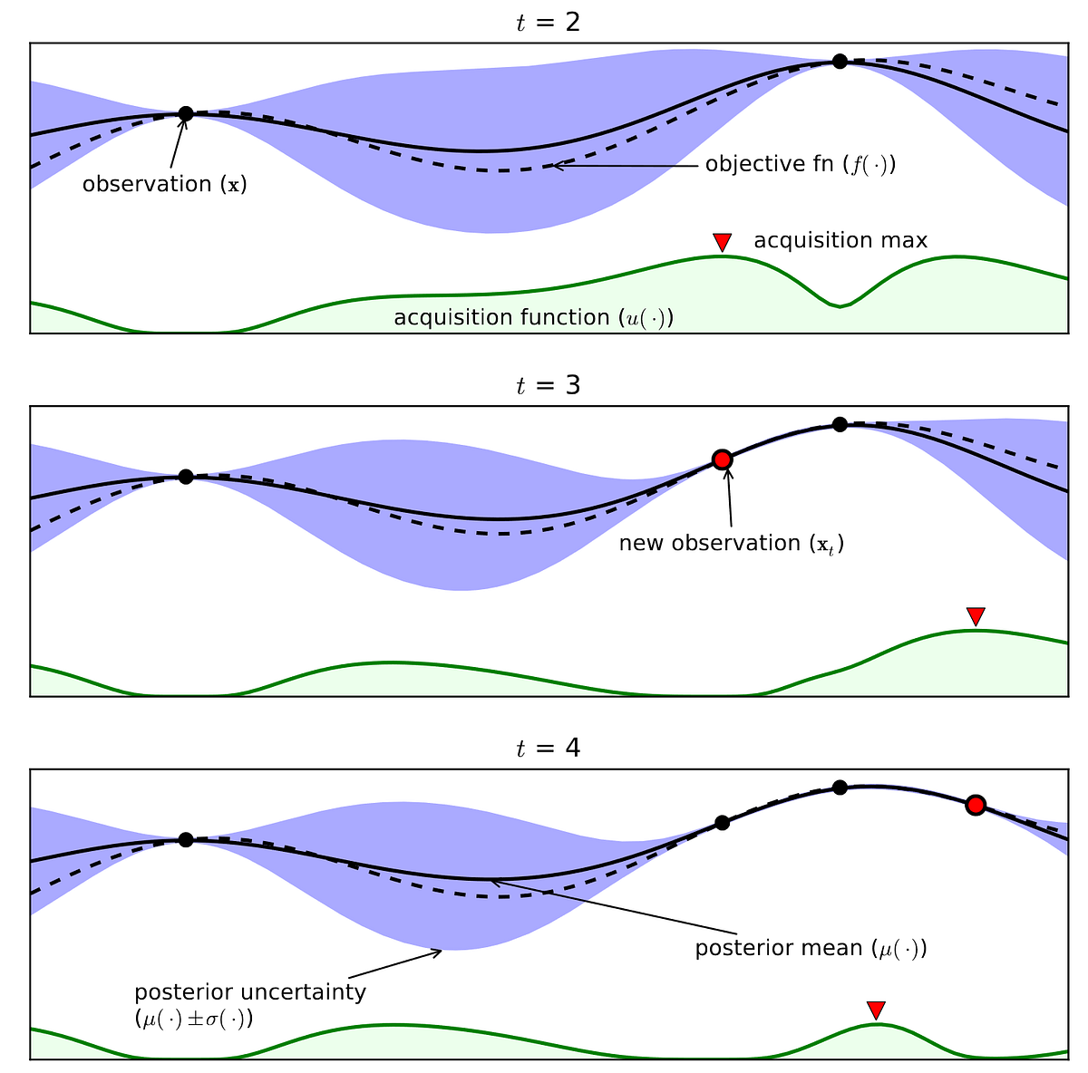
Learning to learn without gradient descent by gradient descent
Now start with black-box Bayesian optimization
(e.g., for experimental design)
Source: Shallow Understanding on Bayesian Optimization, Ramraj Chandradevan

Slide 23
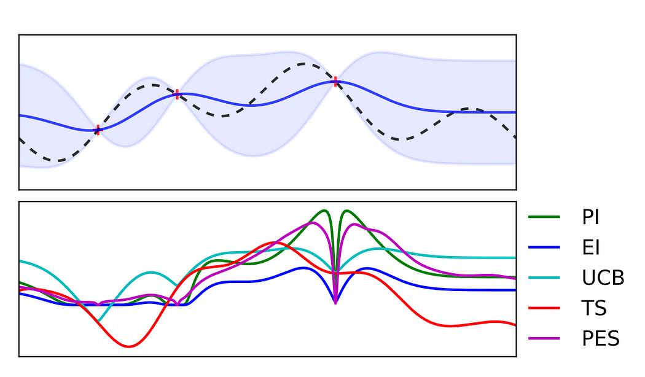
Learning to learn without gradient descent by gradient descent
Now start with black-box Bayesian optimization
Challenges (again):
Solving one optimization problem is hard 🫠
Many acquisition function choices 😵‍💫
Source: Shallow Understanding on Bayesian Optimization, Ramraj Chandradevan

Slide 24
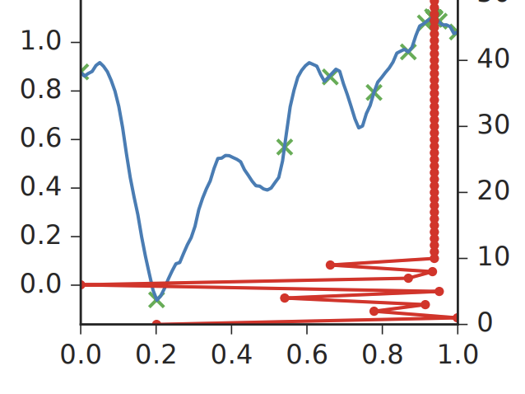
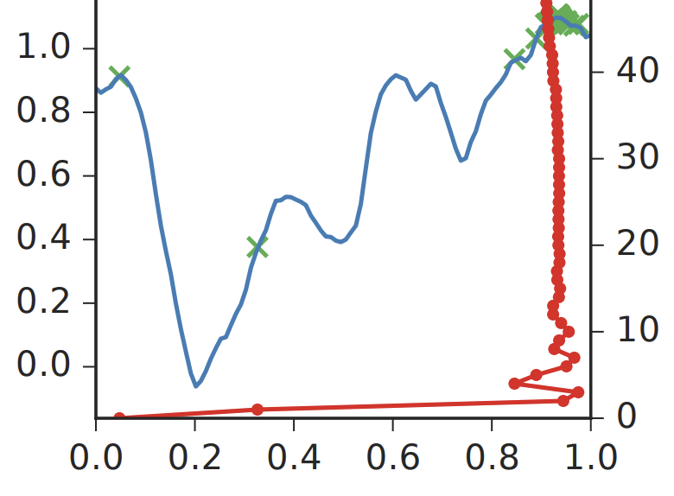
Learning to learn without gradient descent by gradient descent
standard Bayesian optimization
Now start with black-box Bayesian optimization
Challenges (again):
Solving one optimization problem is hard 🫠
Many acquisition function choices 😵‍💫
This paper: learn the updates (again with amortization)
learned updates (solves fast)

Slide 25
Overview
Introduction and motivation for amortization
Warmup: reinforcement learning as amortization
Learning update rules Learning to learn by gradient descent by gradient descent
Learning to learn without gradient descent by gradient descent
Meta Optimal Transport and Meta Flow Matching

Slide 26
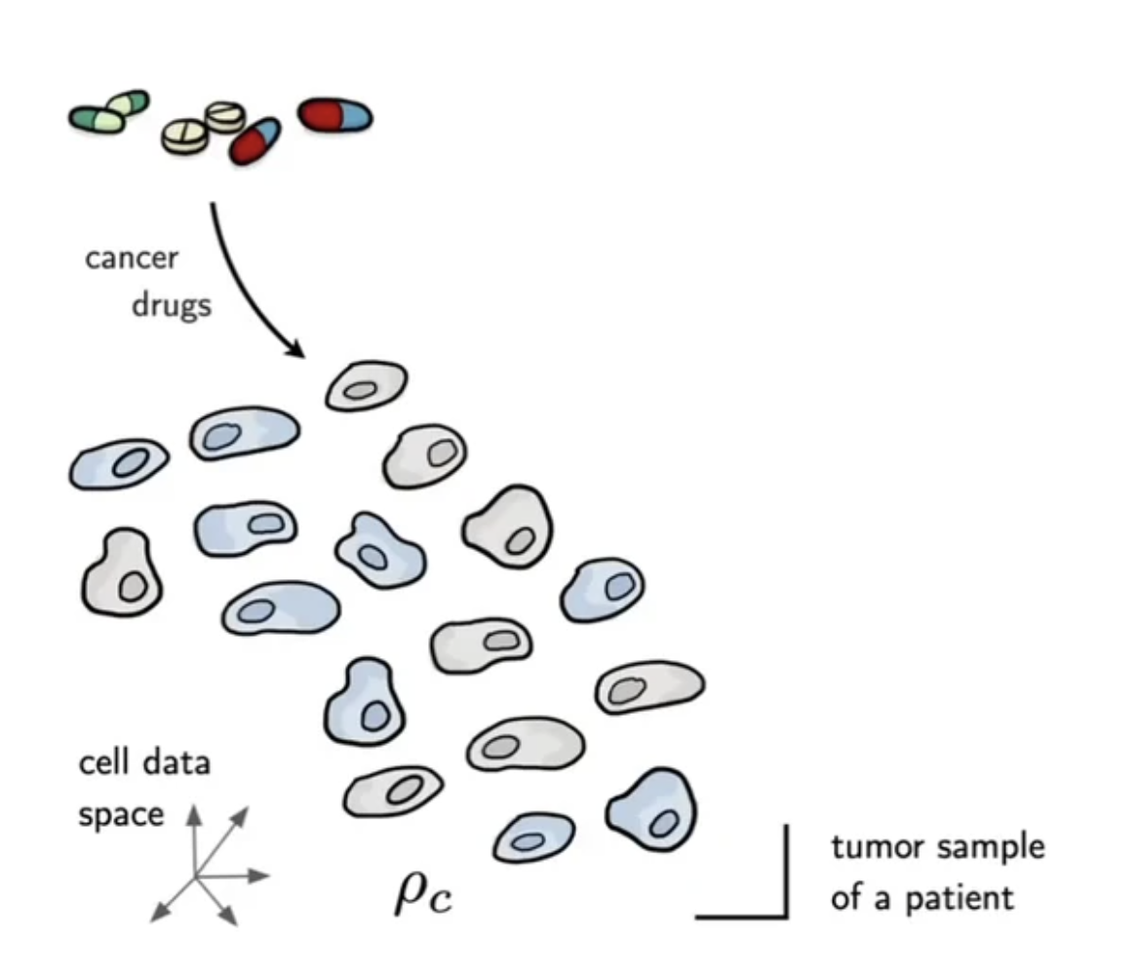
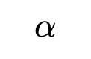
Motivation: transporting between populations
📚 Supervised Training of Conditional Monge Maps. Bunne, Krause, Cuturi, NeurIPS 2022.
$$α$$
Image source: Bunne et al.

Slide 27
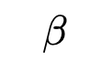
Motivation: transporting between populations
📚 Supervised Training of Conditional Monge Maps. Bunne, Krause, Cuturi, NeurIPS 2022.
$$β$$
$$α$$
Image source: Bunne et al.

Slide 28
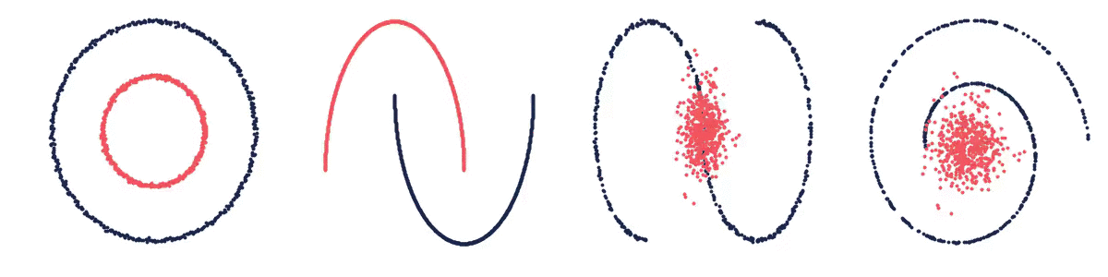








Optimal transport problems
Monge (primal, Wasserstein-2)
$${T^{⋆}(α, β)∈\underset{T∈𝒞\left(α, β\right)}{argmin}{𝔼_{x∼α}\left\|x−T\left(x\right)\right\|}}_{2}^{2}$$
$α,β$ are measures $𝒞\left(α, β\right)$ is the set of valid couplings $T$ is a transport map from $α$ to $β$
$$β$$
$$α$$
$$β$$
$$α$$
$$α$$
$$α$$
$$β$$
$$β$$
Image source:
📚 On amortizing convex conjugates for optimal transport. Amos, ICLR 2023.

Slide 29

Optimal transport problems
Monge (primal, Wasserstein-2)
$${T^{⋆}(α, β)∈\underset{T∈𝒞\left(α, β\right)}{argmin}{𝔼_{x∼α}\left\|x−T\left(x\right)\right\|}}_{2}^{2}$$
$α,β$ are measures $𝒞\left(α, β\right)$ is the set of valid couplings $T$ is a transport map from $α$ to $β$
Challenge: solving even once is hard

Slide 30

Real world: repeatedly solve
Supply-demand transport
Pairs of images
Cell transport

Slide 31




Meta Optimal Transport
📚 Meta Optimal Transport. Amos, Cohen, Luise, Redko, ICML 2023.
Idea: predict the solution to OT problems with amortized optimization
Simultaneously solve many OT problems, sharing info between instances
Monge (primal, Wasserstein-2)
$${T^{⋆}(α, β)∈\underset{T∈𝒞\left(α, β\right)}{argmin}{𝔼_{x∼α}\left\|x−T\left(x\right)\right\|}}_{2}^{2}$$
$$≈$$
${\hat{T}}_{θ}\left(α, β\right)$ (parameterize dual potential via an MLP)
we also consider other/discrete OT formulations

Slide 32



Meta OT for Discrete OT (Sinkhorn)
📚 Meta Optimal Transport. Amos, Cohen, Luise, Redko, ICML 2023.
📚 Sinkhorn Distances: Lightspeed Computation of Optimal Transport. Cuturi, NeurIPS 2013.

Slide 33







Meta Flow Matching
📚 Meta Flow Matching. Atanackovic, Zhang, Amos, Blanchette, Lee, Bengio, Tong, Neklyudov, ICLR, 2025.
Standard flow matching
Meta flow matching
Amortize flows given conditioning $c$
(similar to text-conditioned diffusion)
📚 Flow Matching for Generative Modeling. Lipman et al., ICLR 2023.
📚 Flow Straight and Fast. Liu, Gong, Liu, ICLR 2023.
📚 Stochastic interpolants. Albergo et al., 2023.
$$\min_{θ}{ 𝔼_{t,{π(x}_{0},x_{1})}{\left\|u_{θ}\left(t, x_{t}\right)−u_{t}\left(x | {x_{0},x}_{1}\right)\right\|}^{2}}$$
$$\min_{θ}{ 𝔼_{t,c,{π(x}_{0},x_{1}|c)}{\left\|u_{θ}\left(t, x_{t}|c\right)−u_{t}\left(x | {x_{0},x}_{1},c\right)\right\|}^{2}}$$
Cell data
Image source: Fjelde, Mathieu, Dutordoir. https://mlg.eng.cam.ac.uk/blog/2024/01/20/flow-matching.html

Slide 34

Concluding thoughts
optimal action
cost
context
Optimization-based reasoning a foundation for AI systems
Slow thinking (system 2): formulating and solving it
Fast thinking (system 1): amortizing and distilling it
Many instances of us manually amortizing
Future AI systems (?)
automatically formulating and amortizing optimization problems
understanding the right abstraction (latent space) and objectives
developing intrinsically and extrinsically motivated problems
$$y_{θ}\left(x\right)≈y^{⋆}\left(x\right)∈\underset{y∈𝒞(x)}{argmin}{f(y;x)}$$
amortized solution
actions
action space

Slide 35







Other amortization we’ve been up to
amortized sampling
amortized LLM attacks
amortized OT, geodesics

Slide 36
On amortized optimization for RL, Bayesian optimization, and biology
Brandon Amos • Meta, NYC
Introduction and motivation for amortization
Warmup: reinforcement learning as amortization
Learning update rules Learning to learn by gradient descent by gradient descent
Learning to learn without gradient descent by gradient descent
Meta Optimal Transport and Meta Flow Matching
slides
bamos.github.io/presentations

